Slide 1
Comparing Means:
Confidence Intervals and Hypotheses Tests for the Difference between Two Population Means µ₁ - µ₂
Chapter 24 Independent Samples
Chapter 25 Paired Data

Slide 2
Confidence Intervals for the Difference between Two Population Means µ₁ - µ₂: Independent Samples
Two random samples are drawn from the two populations of interest.
Because we compare two population means, we use the statistic .

Slide 3
Population 1 Population 2
Parameters: µ₁ and σ₁² Parameters: µ₂ and σ₂²
(values are unknown) (values are unknown)
Sample size: n₁ Sample size: n₂
Statistics: x₁ and s₁² Statistics: x₂ and s₂²
Estimate µ₁− µ₂ with x₁− x₂

Slide 4
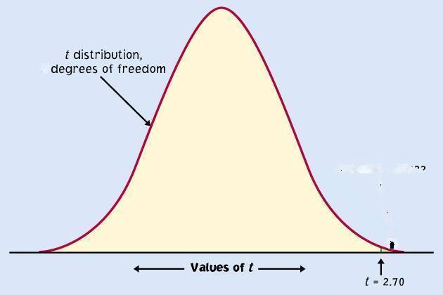
Sampling distribution model for ?
Estimate using
Shape?
Approximately t dist. with
df
Sometimes used (not always very good) estimate of the degrees of freedom is
min(n₁ − 1, n₂ − 1).
₀

Slide 5
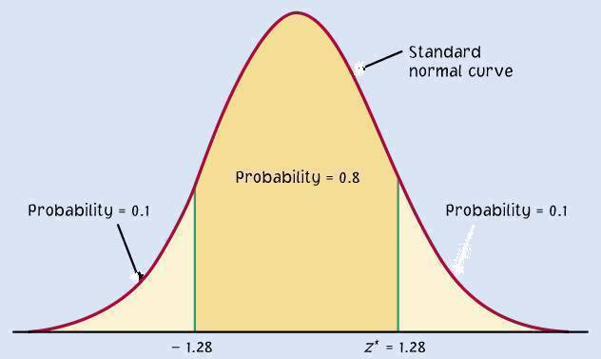
Two sample t-confidence interval with confidence level C
Practical use of t: t*
C is the area between −t* and t*.
If df is an integer, we can find the value of t* in the line of the t-table for the correct df and the column for confidence level C.
If df is not an integer find the value of t* using technology.
C
−t*
t*

Slide 6
Confidence Interval for μ₁ – μ₂

Slide 7

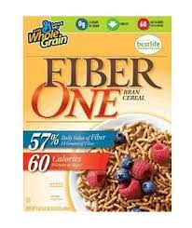
Example: 95% confidence interval for μ₁ – μ₂
Example
  Do people who eat high-fiber cereal for breakfast consume, on average, fewer calories for lunch than people who do not eat high-fiber cereal for breakfast?
  A sample of 150 people was randomly drawn. Each person was identified as a consumer or a non-consumer of high-fiber cereal.
  For each person the number of calories consumed at lunch was recorded.

Slide 8

Example: 95% confidence interval for μ₁ – μ₂
Solution:
The parameter to be tested is
the difference between two means.
The claim to be tested is:
The mean caloric intake of consumers (μ₁)
is less than that of non-consumers (μ₂).

Slide 9



Example: 95% confidence interval for μ₁ – μ₂
Let’s use df = 122.6; t_{122.6}* = 1.9795
The confidence interval estimator for
the difference between two means is…

Slide 10
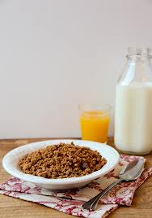
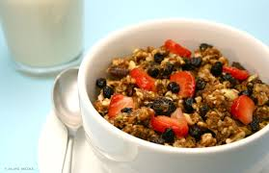
Interpretation
The 95% CI is (-56.862, -1.56).
Since the interval is entirely negative (that is, does not contain 0), there is evidence from the data that µ₁ is less than µ₂. We estimate that non-consumers of high-fiber breakfast consume on average between 1.56 and 56.862 more calories for lunch.

Slide 11
Example: (cont.) confidence interval for μ₁ – μ₂ using min(n₁ –1, n₂ -1) to approximate the df
Let’s use df = min(43-1, 107-1) = min(42, 106) = 42;
t₄₂* = 2.0181
The confidence interval estimator for the difference between two means is

Slide 12

Beware!! Common Mistake !!!
A common mistake is to calculate a one-sample
confidence interval for μ₁, a one-sample confidence interval for μ₂, and to then conclude that μ₁ and μ₂ are equal if the confidence intervals overlap.
This is WRONG because the variability in the sampling distribution for from two independent samples is more complex and must take into account variability coming from both samples. Hence the more complex formula for the standard error.

Slide 13


INCORRECT Two single-sample 95% confidence intervals: The confidence interval for the male mean and the confidence interval for the female mean overlap, suggesting no significant difference between the true mean for males and the true mean for females.
Male interval: (18.68, 20.12)
 | Male | Female
mean | 19.4 | 17.9
st. dev. s | 2.52 | 3.39
n | 50 | 50
Female interval: (16.94, 18.86)
0
.313
1.5
2.69

Slide 14
Reason for Contradictory Result

Slide 15
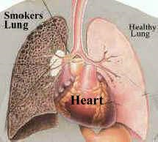
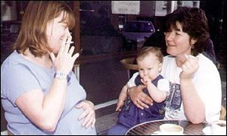
Does smoking damage the lungs of children exposed to parental smoking?
Forced vital capacity (FVC) is the volume (in milliliters) of air that an individual can exhale in 6 seconds.
FVC was obtained for a sample of children not exposed to parental smoking and a group of children exposed to parental smoking.
Parental smoking | FVC | s | n
Yes | 75.5 | 9.3 | 30
No | 88.2 | 15.1 | 30
We want to know whether parental smoking decreases children’s lung capacity as measured by the FVC test.
Is the mean FVC lower in the population of children exposed to parental smoking?

Slide 16
Parental smoking | FVC | s | n
Yes | 75.5 | 9.3 | 30
No | 88.2 | 15.1 | 30
95% confidence interval for (µ₁ − µ₂), with
df = 48.23→ t* = 2.0104:
₁ = mean FVC of children with a smoking parent;
₂ = mean FVC of children without a smoking parent
We are 95% confident that lung capacity is between 19.21 and 6.19 milliliters LESS in children of smoking parents.

Slide 17


Do left-handed people have a shorter life-expectancy than right-handed people?
Some psychologists believe that the stress of being left-handed in a right-handed world leads to earlier deaths among left-handers.
Several studies have compared the life expectancies of left-handers and right-handers.
One such study resulted in the data shown in the table.
left-handed presidents
Handedness | Mean age at death | s | n
Left | 66.8 | 25.3 | 99
Right | 75.2 | 15.1 | 888
star left-handed quarterback Steve Young
We will use the data to construct a confidence interval for the difference in mean life expectancies for left-handers and right-handers.
Is the mean life expectancy of left-handers less than the mean life expectancy of right-handers?

Slide 18
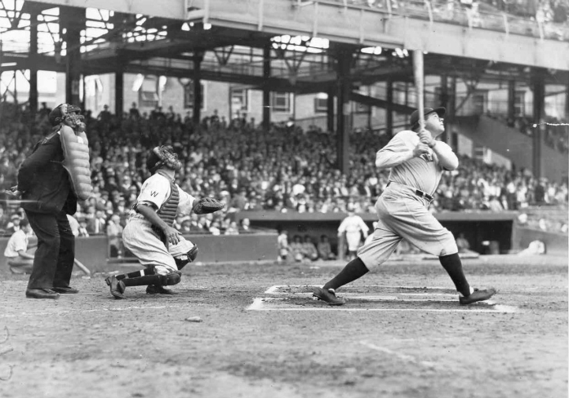
Handedness | Mean age at death | s | n
Left | 66.8 | 25.3 | 99
Right | 75.2 | 15.1 | 888
95% confidence interval for (µ₁ − µ₂), with
df = 105.92→ t* = 1.9826:
The “Bambino”,left-handed Babe Ruth, baseball’s all-time best player.
₁ = mean life expectancy of left-handers;
₂ = mean life expectancy of right-handers
We are 95% confident that the mean life expectancy for left-handers is between 3.27 and 13.53 years LESS than the mean life expectancy for right-handers.

Slide 19
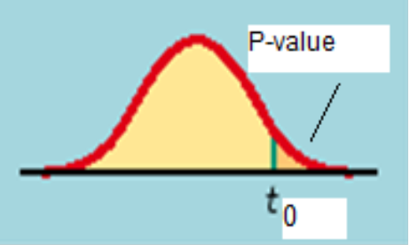
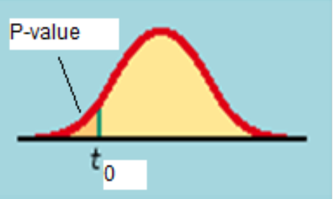
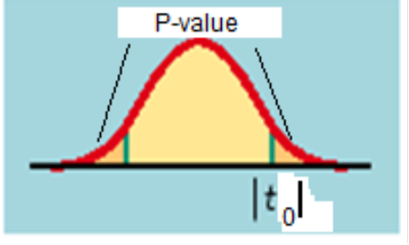
Two-sample t-test
The null hypothes H₀ is that both
population means μ₁ and μ₂ are equal, thus their difference is equal to zero.
P-value=P(t > t₀)
P-value=P(t < t₀)
P-value=2P(t > |t₀|)
Because in a two-sample test H₀ says (μ₁ − μ₂) = 0, the test statistic is …

Slide 20
Does smoking damage the lungs of children exposed to parental smoking?
Forced vital capacity (FVC) is the volume (in milliliters) of air that an individual can exhale in 6 seconds.
FVC was obtained for a sample of children not exposed to parental smoking and a group of children exposed to parental smoking.
Parental smoking | FVC | s | n
Yes | 75.5 | 9.3 | 30
No | 88.2 | 15.1 | 30
We want to know whether parental smoking decreases children’s lung capacity as measured by the FVC test.
Is the mean FVC lower in the population of children exposed to parental smoking?

Slide 21
Parental smoking | FVC | s | n
Yes | 75.5 | 9.3 | 30
No | 88.2 | 15.1 | 30
H₀: μ₁ − μ₂ = 0 df = 48.23
H_{a}: μ₁ − μ₂ < 0
₁ = mean FVC of children with a smoking parent;
₂ = mean FVC of children without a smoking parent
P-value=P(t<-3.9)  .0001
Conclusion: Reject H₀. Lung capacity is
significantly impaired in children of smoking parents.
Recall the 95% CI for μ₁ − μ₂: (−19.21, −6.19)

Slide 22
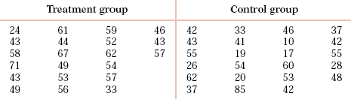

Can directed reading activities in the classroom help improve reading ability? A class of 21 third-graders participates in these activities for 8 weeks while a control classroom of 23 third-graders follows the same curriculum without the activities. After 8 weeks, all children take a reading test (scores in table).
₁ = mean test score of activities participants
₂ = mean test score of controls
P-value=P(t_{37.86} > 2.31) = .013
There is evidence that reading activities improve reading ability.

Slide 23
Robustness
The two-sample t procedures are more robust than the one-sample t procedures. They are the most robust when both sample sizes are equal and both sample distributions are similar. But even when we deviate from this, two-sample tests tend to remain quite robust.
➔ When planning a two-sample study, choose equal sample sizes if you can.
As a guideline, a combined sample size (n₁ + n₂) of 40 or more will allow you to work even with the most skewed distributions.

Slide 24
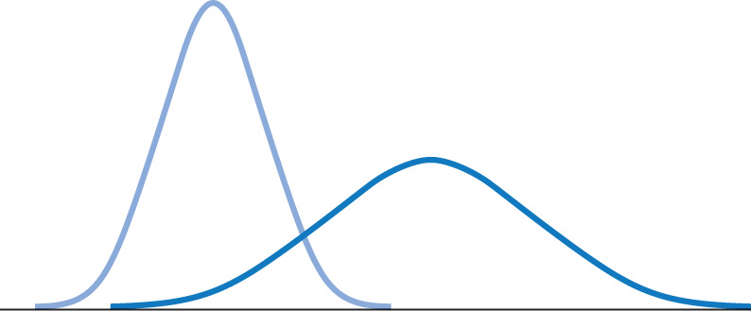
Pooled two-sample procedures
There are two versions of the two-sample t-test: one assuming equal variance (“pooled 2-sample test”) and one not assuming equal variance (“unequal” variance, as we have studied) for the two populations. They have slightly different formulas and degrees of freedom.
The pooled (equal variance) two-sample t-test was often used before computers because it has exactly the t distribution for degrees of freedom n₁ + n₂ − 2.
However, the assumption of equal variance is hard to check, and thus the unequal variance test is safer.
Two normally distributed populations with unequal variances

Slide 25



Pooled two-sample procedures (cont.)
When both population have the
same standard deviation, the
pooled estimator of σ² is:
The sampling distribution for has exactly the t distribution with (n₁ + n₂ − 2) degrees of freedom.
A level C confidence interval for µ₁ − µ₂ is
(with area C between −t* and t*)
  To test the hypothesis H₀: µ₁- µ₂ = 0 against a
  one-sided or a two-sided alternative, compute the pooled two-sample t statistic for the t(n₁ + n₂ − 2) distribution.

Slide 26
Matched pairs t procedures
Sometimes we want to compare treatments or conditions at the individual level. These situations produce two samples that are not independent — they are related to each other. The members of one sample are identical to, or matched (paired) with, the members of the other sample.
  Example: Pre-test and post-test studies look at data collected on the same sample elements before and after some experiment is performed.
  Example: Twin studies often try to sort out the influence of genetic factors by comparing a variable between sets of twins.
  Example: Using people matched for age, sex, and education in social studies allows canceling out the effect of these potential lurking variables.

Slide 27
Matched pairs t procedures
The data:
  “before”: x₁₁ x₁₂ x₁₃ … x_{1n}
  “after”: x₂₁ x₂₂ x₂₃ … x_{2n}
The data we deal with are the differences d_{i} of the paired values:
d₁ = x₁₁ – x₂₁ d₂ = x₁₂ – x₂₂ d₃ = x₁₃ – x₂₃ … d_{n} = x_{1n} – x_{2n}
A confidence interval for matched pairs data is calculated just like a confidence interval for 1 sample data:
A matched pairs hypothesis test is just like a one-sample test:
H₀: µ_{difference}= 0 ; H_{a}: µ_{difference}>0 (or <0, or ≠0)

Slide 28

Sweetening loss in colas
The sweetness loss due to storage was evaluated by 10 professional tasters (comparing the sweetness before and after storage):
Taster
1 2.0 95% Confidence interval:
2 0.4 1.02 ± 2.2622(1.196/sqrt(10)) = 1.02 ±2.2622(.3782)
3 0.7 = 1.02 ± .8556 =(.1644, 1.8756)
4 2.0
5 −0.4
6 2.2
7 −1.3
8 1.2
9 1.1
10 2.3
Summary stats: = 1.02, s = 1.196
Before sweetness – after sweetness
We want to test if storage results in a loss of sweetness, thus:
H₀: μ_{difference} = 0
versus H_{a}: μ_{difference} > 0
This is a pre-/post-test design and the variable is the cola sweetness before storage minus cola sweetness after storage.
A matched pairs test of significance is indeed just like a one-sample test.

Slide 29
Sweetening loss in colas hypothesis test
H₀: μ_{difference} = 0 vs H_{a}: μ_{difference} > 0
Test statistic
From t-table: for df=9,
2.2622 <t=2.6970<2.8214
⇒ .01 < P-value < .025
ti83 gives P-value = .012263…
Conclusion: reject H₀ and conclude colas do lose sweetness in storage (note that CI was entirely positive.

Slide 30
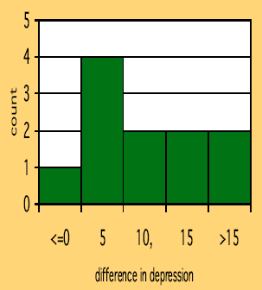
Does lack of caffeine increase depression?
Individuals diagnosed as caffeine-dependent are
deprived of caffeine-rich foods and assigned
to receive daily pills. Sometimes, the pills
contain caffeine and other times they contain
a placebo. Depression was assessed (larger number means more depression).
  There are 2 data points for each subject, but we’ll only look at the difference.
  The sample distribution appears appropriate for a t-test.
11 “difference”
data points.

Slide 31
Hypothesis Test: Does lack of caffeine increase depression?
For each individual in the sample, we have calculated a difference in depression score (placebo minus caffeine).
There were 11 “difference” points, thus df = n − 1 = 10.
We calculate that = 7.36; s = 6.92
H₀ :μ_{difference} = 0 ; H_{a}: μ_{difference} > 0
For df = 10, 3.169 < t = 3.53 < 3.581 ➔ 0.005 > p > 0.0025
ti83 gives P-value = .0027
Caffeine deprivation causes a significant increase in depression.

Slide 32
Which type of test? One sample, paired samples, two samples?
Comparing vitamin content of bread immediately after baking vs. 3 days later (the same loaves are used on day one and 3 days later).
  Paired
Comparing vitamin content of bread immediately after baking vs. 3 days later (tests made on independent loaves).
  Two samples
Average fuel efficiency for 2005 vehicles is 21 miles per gallon. Is average fuel efficiency higher in the new generation “green vehicles”?
  One sample
Is blood pressure altered by use of an oral contraceptive? Comparing a group of women not using an oral contraceptive with a group taking it.
  Two samples
Review insurance records for dollar amount paid after fire damage in houses equipped with a fire extinguisher vs. houses without one. Was there a difference in the average dollar amount paid?
  Two samples

